Slide 1



Class 3: Introduction to Business Intelligence
Unit I: Data Cleaning and Transformation
Sebastián Muñoz-Herrera, PhD.
Héctor Hormazábal

Slide 2
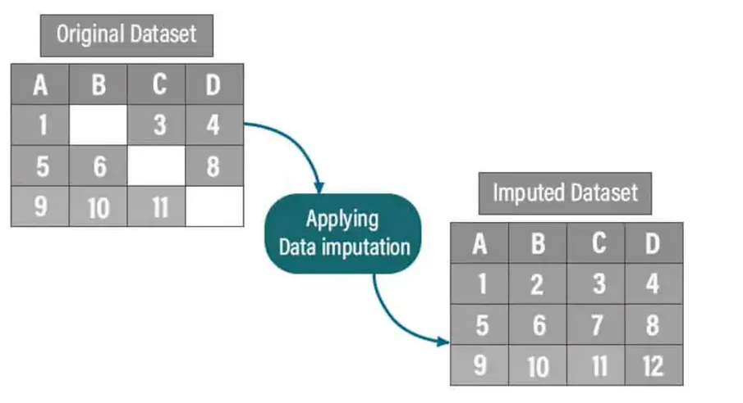
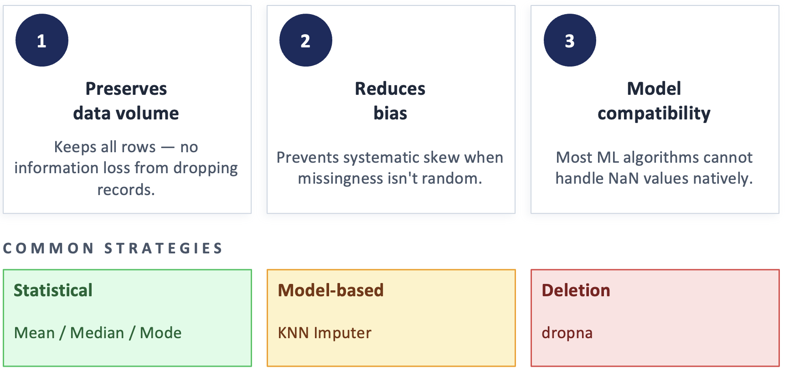
Imputation
Imputation is the process of replacing missing values in a dataset with estimated substitutes, allowing analysis to proceed without discarding incomplete records.
Why this matter?
Muñoz-Herrera and Hormazábal Clase 3: Data Cleaning and Transformation Unit 1: Fundamentals of Business Intelligence

Slide 3
Imputation: KNN Imputer
Example:
Person | Age | Hours studied | Score
A | 20 | 5 | 70
B | 22 | 3 | 60
C | 21 | 4 | ?
D | 25 | 2 | 50
E | 19 | 6 | 80
K-Nearest Neighbors (KNN) Imputation fills in missing values by finding the k most similar rows (neighbors) based on the available features, then using their values to estimate the missing one — typically via mean (for numeric) or mode (for categorical).
Muñoz-Herrera and Hormazábal Clase 3: Data Cleaning and Transformation Unit 1: Fundamentals of Business Intelligence

Slide 4

Imputation: KNN Imputer
Person | Age diff² | Hours diff² | Distance
A | (20−21)² = 1 | (5−4)² = 1 | √(1+1) ≈ 1.41
B | (22−21)² = 1 | (3−4)² = 1 | √(1+1) ≈ 1.41
D | (25−21)² = 16 | (2−4)² = 4 | √(16+4) ≈ 4.47
E | (19−21)² = 4 | (6−4)² = 4 | √(4+4) ≈ 2.83
Step 1: Calculate the euclidean distance between C to every other point using:
$$d= \sqrt{{(Age_{i} −21)}^{2}+ {({Hours}_{i} −4)}^{2}}$$
Muñoz-Herrera and Hormazábal Clase 3: Data Cleaning and Transformation Unit 1: Fundamentals of Business Intelligence

Slide 5
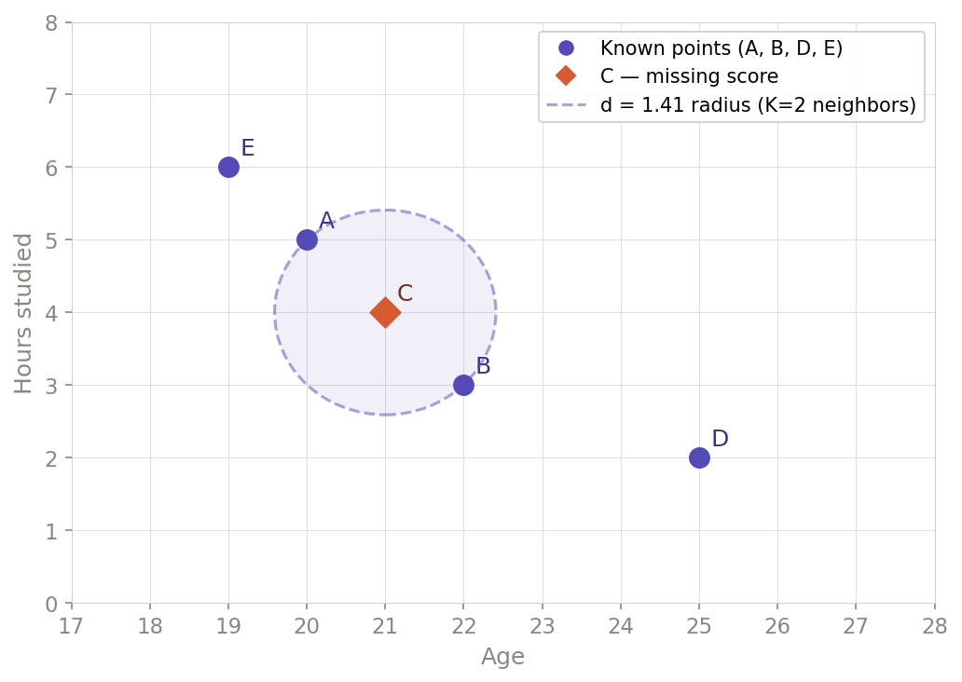
Imputation: KNN Imputer
Step 2: Pick up the 2-nearest neighbors.
Sorted by distance:
A (1.41)
B (1.41)
E (2.83)
D (4.47)
2 nearest neighbors are A and B
Muñoz-Herrera and Hormazábal Clase 3: Data Cleaning and Transformation Unit 1: Fundamentals of Business Intelligence

Slide 6

Imputation: KNN Imputer
Person | Age | Hours studied | Score
A | 20 | 5 | 70
B | 22 | 3 | 60
C | 21 | 4 | 65
D | 25 | 2 | 50
E | 19 | 6 | 80
Step 3: Calculate the average score with the selected neighbors.
$Score_{c}=\frac{Score_{A}+Score_{B}}{2}$ = 65
Muñoz-Herrera and Hormazábal Clase 3: Data Cleaning and Transformation Unit 1: Fundamentals of Business Intelligence

Slide 7
Deduplication: Exact and logical duplications
Exact duplications: Rows that are completely identical across all columns — every field matches perfectly.
Fix using : df.drop_duplicates()
Logical duplicates Rows that represent the same real-world entity but differ in formatting, spelling, or values.
Fix: Needs a business logic. normalize text, match on key fields, use fuzzy matching
ID | Name | Age | Score
1 | Ana | 22 | 85
1 | Ana | 22 | 85
D | Name | Age | Score
1 | Ana | 22 | 85
1 | ANA | 22 | 85
1 | Ana García | 22 | 85
2 | Ana Bernales | 25 | 87
Muñoz-Herrera and Hormazábal Clase 3: Data Cleaning and Transformation Unit 1: Fundamentals of Business Intelligence

Slide 8
Outlier treatment: Winsorization
A technique to handle outliers by capping extreme values at a specified percentile threshold — rather than removing them. The record stays in the dataset; only the extreme value is replaced.
Student | Score | Score – Winsorizated (90th percentile)
A | 55 | 55
B | 60 | 60
C | 62 | 62
D | 65 | 65
E | 68 | 68
F | 70 | 70
G | 72 | 72
H | 98 ← outlier | 72
How it works Choose a percentile limit (commonly 5th–95th or 1st–99th). Any value below the lower threshold is replaced with the lower threshold. Any value above the upper threshold is replaced with the upper threshold.
Muñoz-Herrera and Hormazábal Clase 3: Data Cleaning and Transformation Unit 1: Fundamentals of Business Intelligence

Slide 9
Outlier treatment: Log-transformation
Log transformation applies the logarithm function to a variable, compressing large values more than small ones. This reduces the effect of extreme outliers and can make a skewed distribution more symmetric.
Why it works The log scale grows slowly — the gap between 10 and 100 becomes the same as the gap between 100 and 1,000. Extreme high values are pulled inward; small values spread out slightly.
Person | Income ($) | Log₁₀(Income)
A | 1,000 | 3.00
B | 1,500 | 3.18
C | 2,000 | 3.30
D | 2,500 | 3.40
E | 3,000 | 3.48
F | 120,000 | 5.08
Muñoz-Herrera and Hormazábal Clase 3: Data Cleaning and Transformation Unit 1: Fundamentals of Business Intelligence

Slide 10
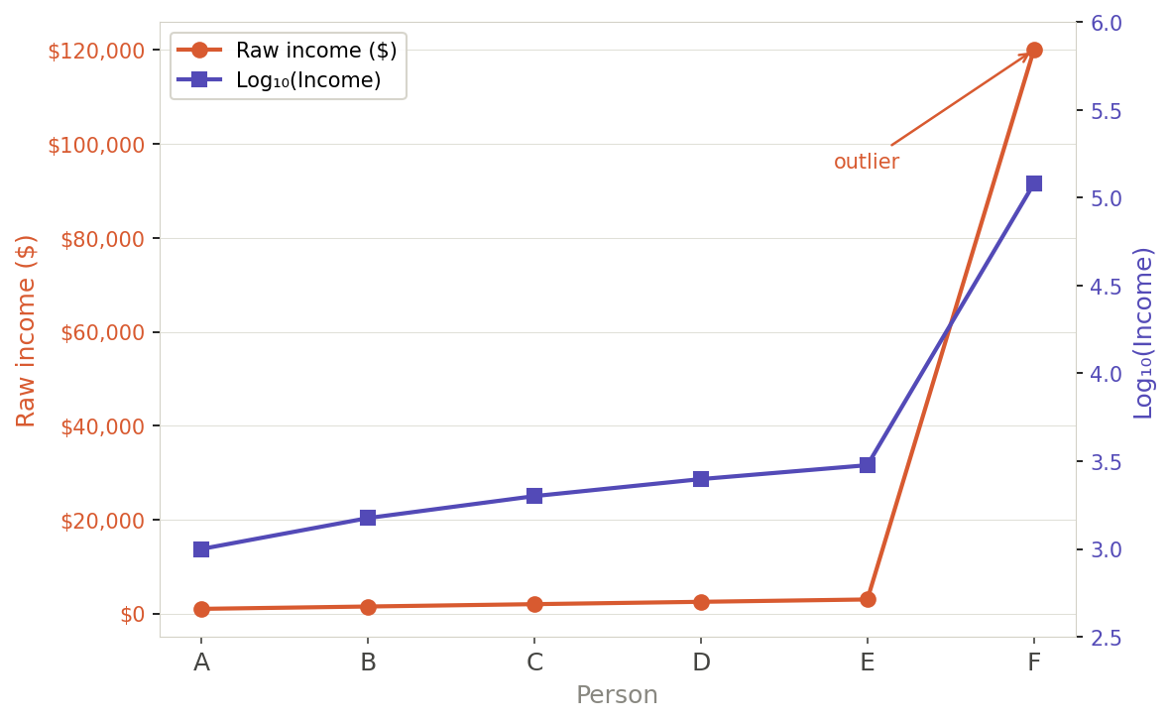
Outlier treatment: Log-transformation
Log transformation applies the logarithm function to a variable, compressing large values more than small ones. This reduces the effect of extreme outliers and can make a skewed distribution more symmetric.
Important Conditions
Condition | Reason
All values must be > 0 | log(0) and log(negative) are undefined
If zeros exist | use log(x + 1) — called log1p
Interpretation changes | model results are on the log scale, must back-transform to interpret
Muñoz-Herrera and Hormazábal Clase 3: Data Cleaning and Transformation Unit 1: Fundamentals of Business Intelligence

Slide 11

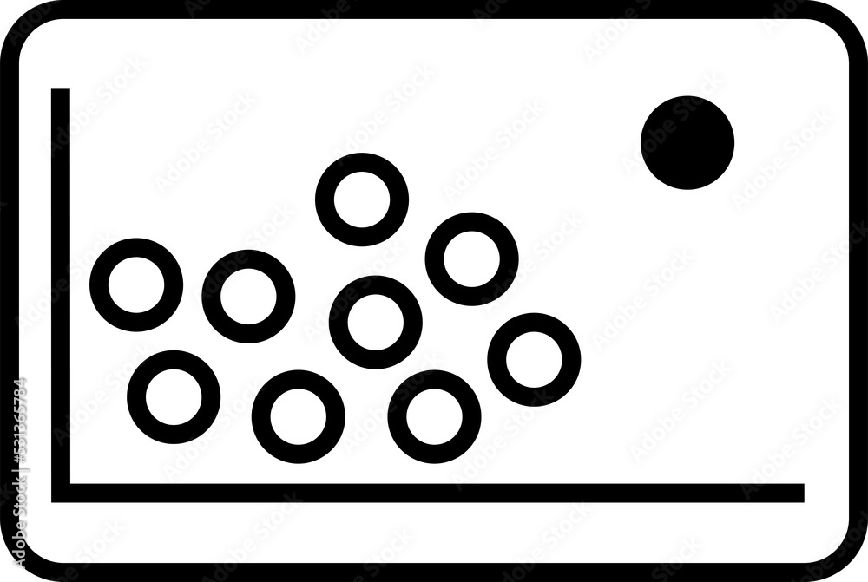
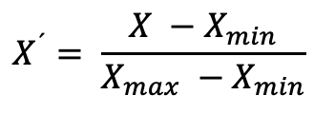
Normalization (Min-Max scaling)
Normalization rescales all values of a variable to a fixed range, typically 0 to 1, by subtracting the minimum and dividing by the range. It preserves the shape of the original distribution but changes the scale.
$$X^{´}= \frac{X −X_{min}}{X_{max} −X_{min}}$$
When to use it When features have different units or scales and the algorithm is sensitive to magnitude — e.g. KNN, neural networks, gradient descent.
Sensitivity to outliers — important caveat If one value is huge in comparison with the others, all other normalized values would be compressed into a tiny range near 0. This is why outliers should be treated before normalizing.
Muñoz-Herrera and Hormazábal Clase 3: Data Cleaning and Transformation Unit 1: Fundamentals of Business Intelligence

Slide 12

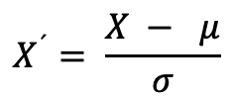
Standarization (Standard scaling)
Rescales values so the variable has a mean of 0 and a standard deviation of 1. Unlike normalization, there is no fixed output range — values can be negative or exceed 1.
$$X^{´}= \frac{X − μ}{σ}$$
No bounded output — unsuitable for algorithms requiring [0, 1] input
Still sensitive to extreme outliers — Z > 3 flags them but doesn't remove them
Fit on training data only — applying to the full dataset causes data leakage
When to use it Algorithm assumes normality or is sensitive to variance — linear/logistic regression, PCA, SVM.
Data contains outliers — less distorted by extremes than normalization.
Features have different units or scales.
Muñoz-Herrera and Hormazábal Clase 3: Data Cleaning and Transformation Unit 1: Fundamentals of Business Intelligence

Slide 13
Categorical handling: Label encoding
Converts categorical text values into integers by assigning each unique category a number. Simple and memory-efficient, but introduces an implicit numeric order that may not exist in the data.
Student | Education | Label encoded
A | High school | 0
B | Bachelor | 1
C | Master | 2
D | PhD | 3
E | Bachelor | 1
When to use it. The variable is ordinal — categories have a meaningful, agreed order. The algorithm is tree-based — decision trees and random forests are not misled by arbitrary integers. Memory or simplicity is a constraint
When NOT to use it. The variable is nominal — no natural order exists. The algorithm is distance-based or linear — KNN, SVM, linear regression will be distorted
Here the encoding is valid — there is a natural order (High school < Bachelor < Master < PhD). Lucky !!
Muñoz-Herrera and Hormazábal Clase 3: Data Cleaning and Transformation Unit 1: Fundamentals of Business Intelligence

Slide 14
Categorical handling: One-hot encoding
Converts categorical text values into integers by assigning each unique category a number. Simple and memory-efficient, but introduces an implicit numeric order that may not exist in the data.
Customer | City
A | Paris
B | London
C | Tokyo
D | Paris
Customer | City_Paris | City_London | City_Tokyo
A | 1 | 0 | 0
B | 0 | 1 | 0
C | 0 | 0 | 1
D | 1 | 0 | 0
When to use it. The variable is nominal — no natural order exists. The algorithm is distance-based or linear — KNN, SVM, linear regression, neural networks
When NOT to use it
The variable has high cardinality — a city column with 500 unique values produces 500 new columns, causing the curse of dimensionality. Memory is a hard constraint.
Muñoz-Herrera and Hormazábal Clase 3: Data Cleaning and Transformation Unit 1: Fundamentals of Business Intelligence

Slide 15
Categorical handling: Ordinal encoding
Converts ordered categorical values into integers that respect the natural order of the categories. The key difference from label encoding is that the numeric mapping is explicitly defined by the analyst — not assigned arbitrarily.
When to use it
The variable is ordinal — a clear, meaningful order exists The order is domain-defined, not inferred automatically Any algorithm — ordinal encoding is safe for both linear and tree-based models when order is genuine.
Student | Education | Label encoded
A | High school | 0
B | Bachelor | 1
C | Master | 2
D | PhD | 3
E | Bachelor | 1
Caveats
Equal spacing is assumed — if the real gap between Master and PhD is much larger than Bachelor and Master, the encoding does not capture that. Never apply to nominal variables. Order must be defined manually.
Muñoz-Herrera and Hormazábal Clase 3: Data Cleaning and Transformation Unit 1: Fundamentals of Business Intelligence

Slide 16
Class 3: Introduction to Business Intelligence
Unit I: Data Cleaning and Transformation
Sebastián Muñoz-Herrera, PhD.
Héctor Hormazábal

